Slide 1
Real Estate
Market Outlook
Lawrence Yun, Ph.D.
Chief Economist
NAR

Slide 2
Annual Existing Home Sales: 18% decline and 19% decline
Worst Year since 1995
Seasonally adjusted annualized sale pace
Source: NAR

Slide 3
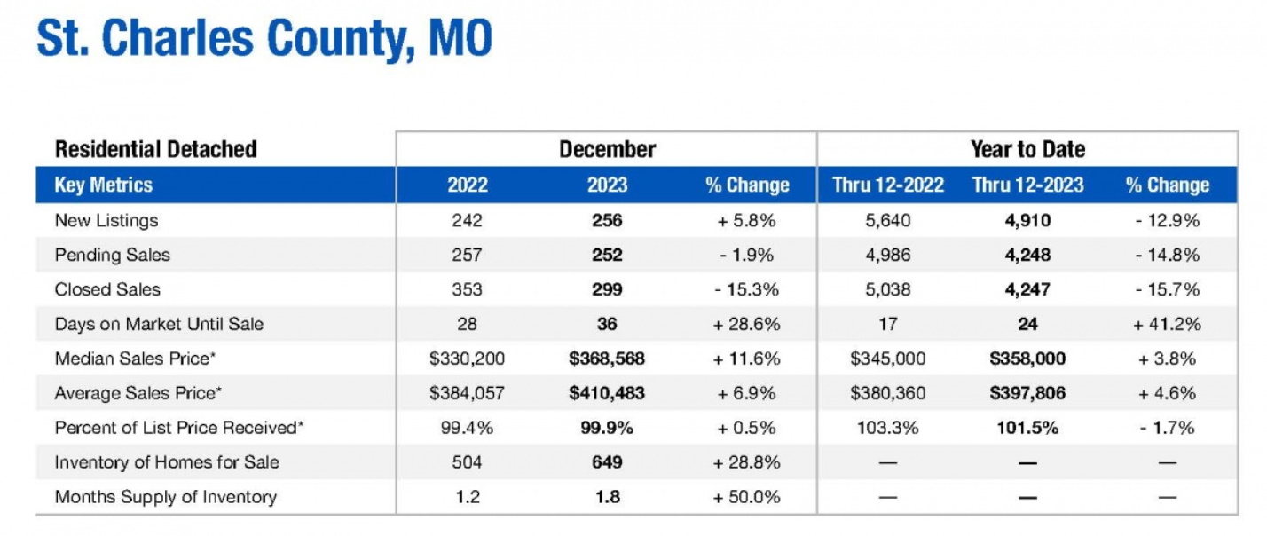
Source: MARIS

Slide 4
Annual New Home Sales
3rd best year since 2008 foreclosure year
Source: Census and HUD

Slide 5
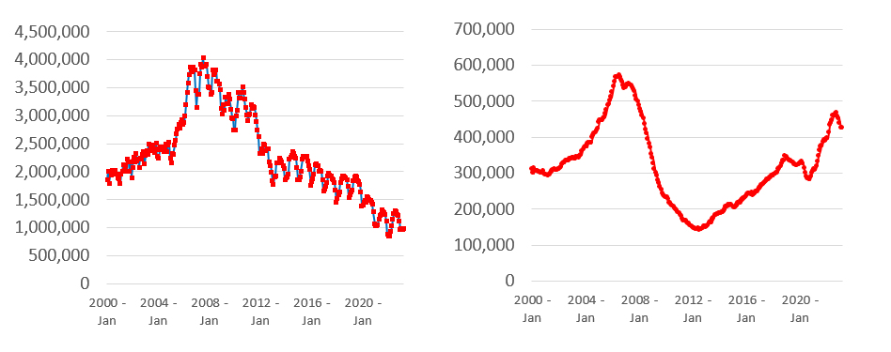
Inventory of Existing Homes Low ... New Homes High
Source: NAR and HUD

Slide 6
New Median Home Price
6.6% lower in 2023
Source: Census and HUD

Slide 7
10-year Treasury yield – Pivoting down
Rising 1st week of 2024 after 2 months of decline
Source: U.S. Treasury

Slide 8
30-year Mortgage and Fed Funds Rate ... Likely Peaked
Source: U.S. Treasury and Federal Reserve

Slide 9
Official Consumer Price Inflation at 3.4% in December
Source: BLS

Slide 10
Pending Contracts Turning Up
Source: U.S. Treasury

Slide 11
Quarterly GDP Growth at 3.3% in 2023 Q4 ... Solid
Seasonally adjusted annualized sale pace
Source: NAR

Slide 12
Annual Economic Growth (GDP)
Seasonally adjusted annualized sale pace
Source: NAR

Slide 13
Total Payroll Jobs
5 million more compared to pre-covid highs
Source: BLS

Slide 14
Monthly Payroll Job Gains
Source: BLS

Slide 15
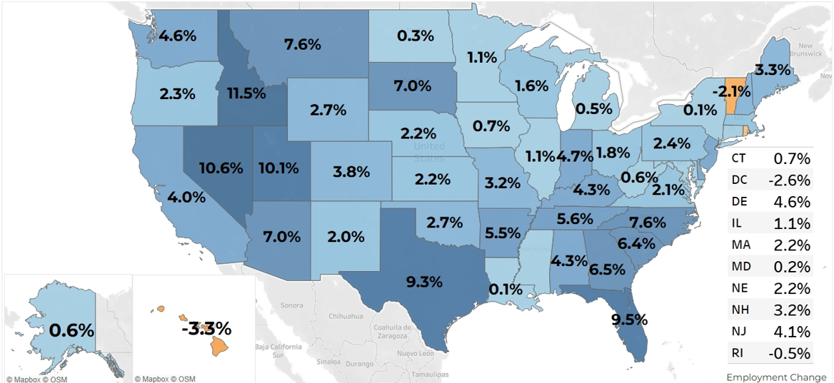
Job Gains Since Pre-Covid Record High Payroll Employment
(% change from March 2020 to December 2023)
Source: NAR Analysis of BLS data

Slide 16
Jobs in St. Louis City
Source: NAR

Slide 17
Jobs in St. Louis and St. Charles Counties
Source: NAR

Slide 18
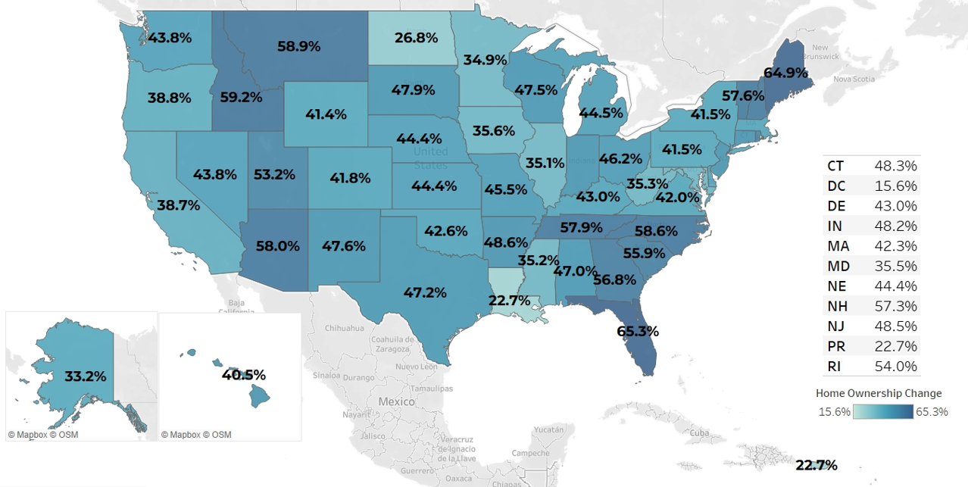
Home Price Appreciation since Covid Arrival
(% change from 2020 Q1 to 2023 Q3)
Source: NAR Analysis of FHFA Home Price Index

Slide 19
St. Louis MSA Median Home Price
In $ thousand
Source: NAR

Slide 20
Wealth Comparison between Owners and Renters
Source: Median Net Worth from Federal Reserve Survey of Consumer Finance

Slide 21
Mortgage Rates to Fall?
30-year Fixed Rate to be 6% to 7% by the early spring
Rents will calm down further ... Holds down CPI ... and allow the Fed to cut interest rates
Community banks are suffering from high interest rates
Spread with government bond with a return to normal

Slide 22
The Spread between 10-year Treasury and 30-year Mortgage
(% point difference)
Mortgage Rate
(before the Fed Rate Cuts)
could be
6.1% to 6.6%
Source: NAR Analysis of Interest Rates

Slide 23
Pent-Up Delayed Sellers Cannot Wait Longer
What happens over 2 years?
7 million new-born babies
3 million marriages
1.5 million divorces
7 million turn 65 years old
4 million deaths
4 million net new jobs
50 million job switches

Slide 24
Total Home Sales: Rising the next two years ... to 2019 pre-covid levels
Source: NAR forecast and HUD

Slide 25
Risks
- Lawsuit on Buyer Representation
- Government Shutdown
- Community Banks
- International Buyers

Slide 26
First-time Homebuyer Down Payment
Down Payment | % of Home Price
0% | 16% of buyers
1% to 5% | 22% of buyers
6% to 10% | 16% of buyers
11% to 20% | 20% of buyers
More than 20% | 26% of buyers
Source: NAR

Slide 27
First-time Homebuyer Challenges
Hardest Part of Buying (more than one answer permitted) | % of First-time buyers
Finding the Right Property | 61% of buyers
Saving for Down Payment | 38% of buyers
Understanding the Process | 38% of buyers
Paperwork | 23% of buyers
Getting a Mortgage and Appraisal | 17% of buyers
Source: NAR

Slide 28
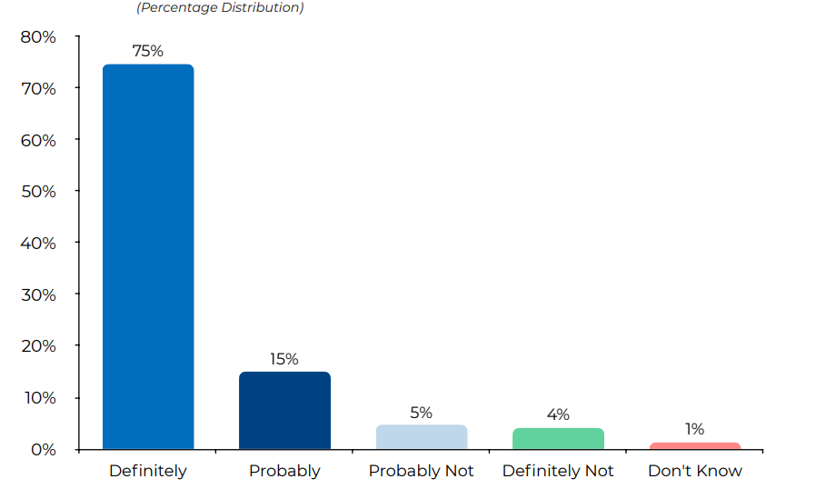
Would Homebuyer Use the Same Agent Again or Recommend to Others?

Slide 29
First-time Home Buyers Race/Ethnicity
First-time Buyer | % breakout
White | 69%
Hispanic | 7%
Black | 7%
Asian | 6%
Other | 6%
Source: NAR

Slide 30
Home Seller Race/Ethnicity
Home Seller | % breakout
White | 89%
Hispanic | 5%
Black | 4%
Asian | 3%
Other | 2%
Source: NAR

Slide 31
Government Shutdown and Annual Budget Deficit
Federal Outlay (blue bar) > Tax Receipts (orange line)
Source: Congressional Budget Office

Slide 32
Commercial Property Prices Falling ...
Below Pre-COVID
Source: Green Street

Slide 33
Fed Rate Hikes Have Hurt Small-Sized Banks ...
Commercial Real Estate Loans by Small Banks > Top 25 Large Banks
Source: Federal Reserve

Slide 34
National Office Vacancy Rate
%
Source: CBRE/ULI and NAR Forecast

Slide 35
Thank You !

